Slide 1
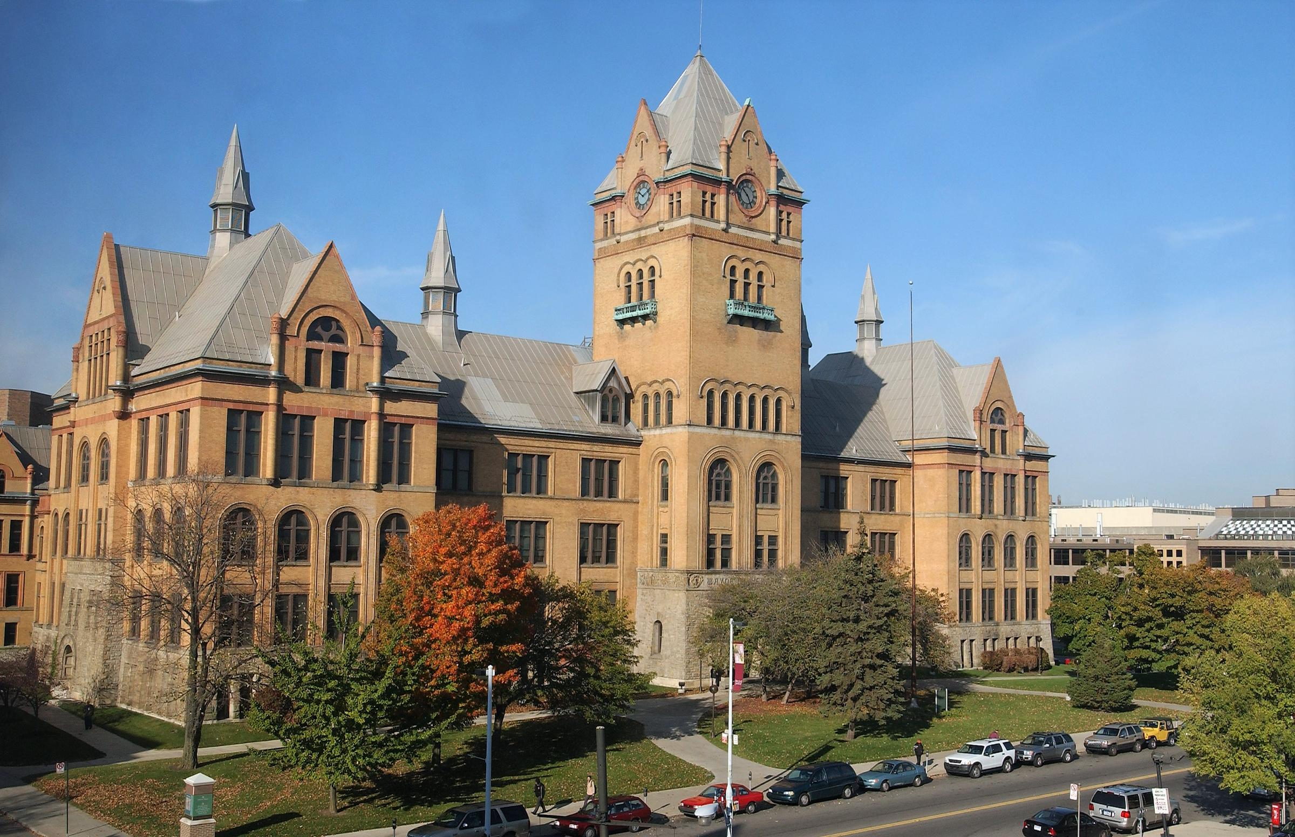
Demand Characterization and Codesign of Dynamics-Adaptive Real-Time Systems
Prospectus Defense - Aaron Willcock (aaron.willcock@wayne.edu)
Advisor – Professor Nathan Fisher (fishern@wayne.edu)

Slide 2
Hard Real-Time Systems

Slide 3
Problem Motivation
Prospectus Defense - Aaron Willcock (aaron.willcock@wayne.edu)
Advisor – Professor Nathan Fisher (fishern@wayne.edu)

Slide 4
Background
Prospectus Defense - Aaron Willcock (aaron.willcock@wayne.edu)
Advisor – Professor Nathan Fisher (fishern@wayne.edu)

Slide 5
Related Works (table/box)
Prospectus Defense - Aaron Willcock (aaron.willcock@wayne.edu)
Advisor – Professor Nathan Fisher (fishern@wayne.edu)

Slide 6

An Efficient Knapsack-Based Approach for Calculating the Worst-Case Demand of AVR Tasks
Sandeep Kumar Bijinemula*, Aaron Willcock†,
Thidapat Chantem*, Nathan Fisher†
*Department of Electrical and Computer Engineering, Virginia Tech, USA
†Department of Computer Science, Wayne State University, USA
Notes:
collaboration

Slide 7
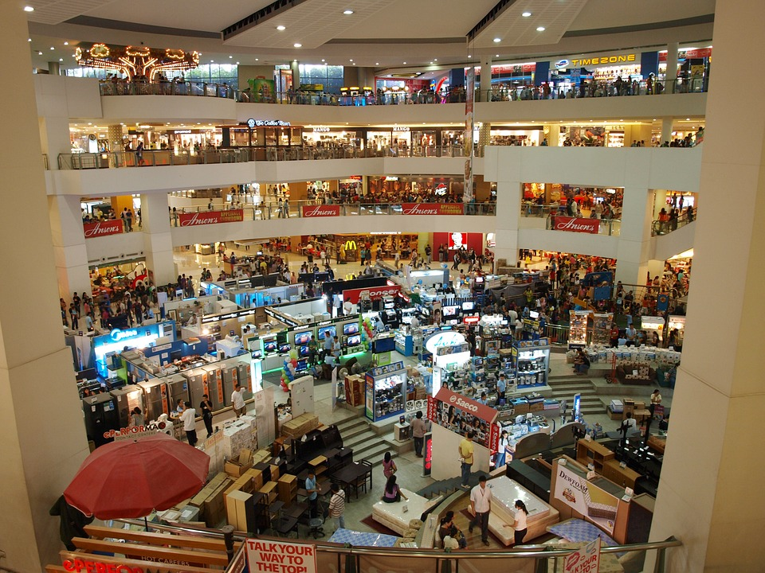
Holiday Thievery
Imagine your favorite store.
You have 100 seconds to take anything …for free
Where would you start?
What would you take?
Notes:
Media Markt. For those who recognize, this is akin to the typical knapsack problem.

Slide 8







Holiday Thievery
Goal:
Maximize value over 100 seconds
Increase value
Decrease time
$$<$$
$$<$$

Slide 9

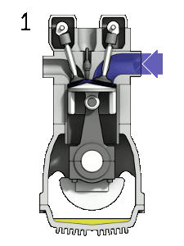
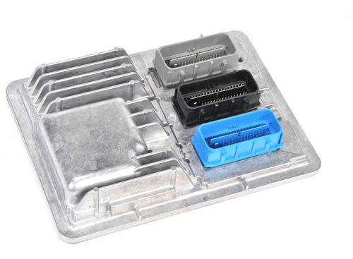



Holiday Thievery Function
Engine Control Module (ECM)
Value of Items
Image Provided by: Zephyris.
https://commons.wikimedia.org/wiki/
File:4StrokeEngine_Ortho_3D_Small.gif
Items per Second

Slide 10
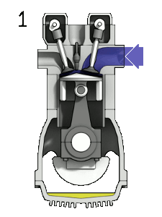
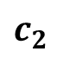
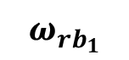
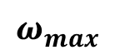
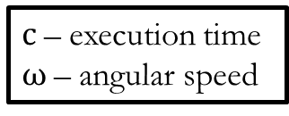
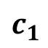
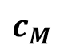
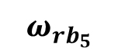
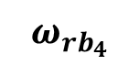
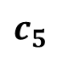
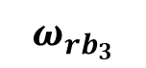
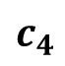
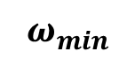
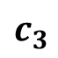
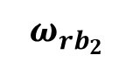
Engine Control: Adaptive Variable-Rate (AVR) Tasks
Holiday Thievery Function
Engine Control Module (ECM)
$$c_{1}$$
Execution Times of the Modes
Value of Items
$$c_{2}$$
$$c_{3}$$
$$c_{4}$$
Image Provided by: Zephyris.
https://commons.wikimedia.org/wiki/
File:4StrokeEngine_Ortho_3D_Small.gif
$$c_{5}$$
$$c_{M}$$
$$ω_{min}$$
$$ω_{{rb}_{1}}$$
$$ω_{{rb}_{2}}$$
$$ω_{{rb}_{3}}$$
$$ω_{{rb}_{4}}$$
$$ω_{{rb}_{5}}$$
$$ω_{max}$$
c – execution time
$ω$ – angular speed
Items per Second
Speeds
Biondi et al. [ICCPS ‘15]

Slide 11
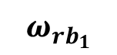
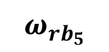
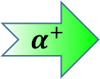
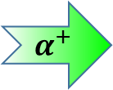
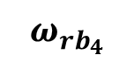
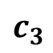
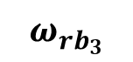
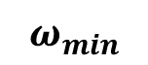
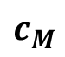
Engine Control: Adaptive Variable-Rate (AVR) Tasks
Jobs released at Top Dead Center (TDC)
Jobs due in one revolution (one full rotation)
$$c_{1}$$
Execution Times of the Modes
$$c_{2}$$
$$α^{+}$$
$$c_{3}$$
Higher rate of job release
$$c_{4}$$
Lower WCET per job
$$c_{5}$$
Higher rate of job release
Less time between job releases
$$c_{M}$$
$$ω_{min}$$
$$ω_{{rb}_{1}}$$
$$ω_{{rb}_{2}}$$
$$ω_{{rb}_{3}}$$
$$ω_{{rb}_{4}}$$
$$ω_{{rb}_{5}}$$
$$ω_{max}$$
c – execution time
$ω$ – angular speed
$$α^{+}$$
Speeds
Biondi et al. [ICCPS ‘15]

Slide 12
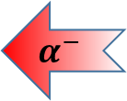

Engine Control: Adaptive Variable-Rate (AVR) Tasks
Jobs released at Top Dead Center (TDC)
Jobs due in one revolution (one full rotation)
$$c_{1}$$
Execution Times of the Modes
$$c_{2}$$
$$α^{−}$$
$$c_{3}$$
But how do we calculate worst-case demand?
Higher rate of job release
$$c_{4}$$
Higher WCET per job
$$c_{5}$$
Higher rate of job release
More time between job releases
$$c_{M}$$
$$ω_{min}$$
$$ω_{{rb}_{1}}$$
$$ω_{{rb}_{2}}$$
$$ω_{{rb}_{3}}$$
$$ω_{{rb}_{4}}$$
$$ω_{{rb}_{5}}$$
$$ω_{max}$$
c – execution time
$ω$ – angular speed
$$α^{−}$$
Speeds
Biondi et al. [ICCPS ‘15]
Notes:
These are real-time tasks which model the behavior of engine control tasks.
As engine speed increases, time between jobs decreases and WCET decreases.

Slide 13
Demand of AVR Tasks
Engine Control: Adaptive Variable-Rate (AVR) Tasks
Which point gives the worst-case demand?
$$c_{1}$$
Execution Times of the Modes
$$c_{2}$$
$$c_{3}$$
$$c_{4}$$
Calculation of worst-case demand is not straightforward.
$$c_{5}$$
$$c_{M}$$
$$ω_{min}$$
$$ω_{{rb}_{1}}$$
$$ω_{{rb}_{2}}$$
$$ω_{{rb}_{3}}$$
$$ω_{{rb}_{4}}$$
$$ω_{{rb}_{5}}$$
$$ω_{max}$$
c – execution time
$ω$ – angular speed
Speeds
Biondi et al. [ICCPS ‘15]
Notes:
These are real-time tasks which model the behavior of engine control tasks.
As engine speed increases, time between jobs decreases and WCET decreases.
We call the stretches of equal value "modes" or "steps" and the rightmost edge of the "step" a "right boundary".

Slide 14
Demand of AVR Tasks
$$c_{1}$$
Execution Times of the Modes
$$c_{2}$$
$$c_{3}$$
$$c_{4}$$
Calculation of worst-case demand is not straightforward.
$$c_{5}$$
$$c_{M}$$
$$ω_{min}$$
$$ω_{{rb}_{1}}$$
$$ω_{{rb}_{2}}$$
$$ω_{{rb}_{3}}$$
$$ω_{{rb}_{4}}$$
$$ω_{{rb}_{5}}$$
$$ω_{max}$$
c – execution time
$ω$ – angular speed
Speeds
Notes:
These are real-time tasks which model the behavior of engine control tasks.
As engine speed increases, time between jobs decreases and WCET decreases.

Slide 15
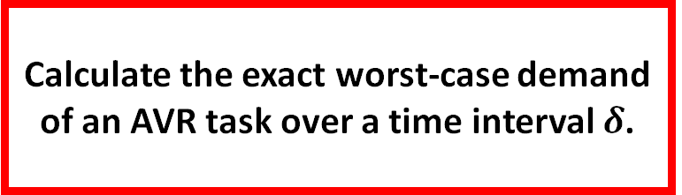
Motivation and Problem Statement
Demand of AVR Tasks
$$c_{1}$$
Motivation:
?
Execution Times of the Modes
Existing calculations of exact worst-case demand for AVR tasks are compute intensive.
$$c_{2}$$
$$c_{3}$$
$$c_{4}$$
Problem Statement:
$$c_{5}$$
Calculate the exact worst-case demand of an AVR task over a time interval $δ$.
$$c_{M}$$
$$ω_{min}$$
$$ω_{{rb}_{1}}$$
$$ω_{{rb}_{2}}$$
$$ω_{{rb}_{3}}$$
$$ω_{{rb}_{4}}$$
$$ω_{{rb}_{5}}$$
$$ω_{max}$$
c – execution time
$ω$ – angular speed
Speeds
Notes:
These are real-time tasks which model the behavior of engine control tasks.
As engine speed increases, time between jobs decreases and WCET decreases.

Slide 16



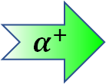
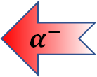
Approach & Contributions
1. Worst-case AVR task demand ↔ Bounded precedence constraint knapsack problem (BPCKP).
↔
2. Symmetric acceleration + Engine kinematics →
Reduced search space.
$$α^{−}$$
$$α^{+}$$
→
3. Results significantly outperform the state-of-the-art in computation time.
?
Notes:
"We make a simplifying assumption that magnitude of acceleration and deceleration is equal"

Slide 17
Outline
Approach and Contributions
Background & Related Work
Precedence Constraints & Search Space Reduction
Worst-Case AVR Demand as Knapsack Problem
Evaluation & Results
Conclusion & Future Work

Slide 18
Background & Related Work

Slide 19
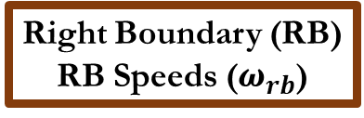
AVR Tasks – Speed or WCET?
$$c_{1}$$
+ Allows WCET to scale inversely with speed
? How can we calculate worst-case demand?
Execution Times of the Modes
$$c_{2}$$
$$c_{3}$$
$$c_{4}$$
Right Boundary (RB) RB Speeds ($ω_{rb}$)
$$c_{5}$$
Modes / Steps
$$c_{M}$$
$$ω_{min}$$
$$ω_{{rb}_{1}}$$
$$ω_{{rb}_{2}}$$
$$ω_{{rb}_{3}}$$
$$ω_{{rb}_{4}}$$
$$ω_{{rb}_{5}}$$
$$ω_{max}$$
c – execution time
$ω$ – angular speed
Speeds
Biondi et al. [ICCPS ‘15]

Slide 20
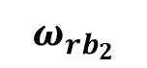
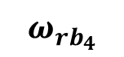
Digraph Real-Time (DRT) Approach
AVR Tasks – Speed or WCET?
+ Exact worst-case demand for a select set of speeds
? How can we compute worst-case demand faster?
$$c_{1}$$
Execution Times of the Modes
$$c_{2}$$
$$c_{3}$$
$$c_{4}$$
$$c_{5}$$
$$c_{M}$$
$$ω_{min}$$
$$ω_{{rb}_{1}}$$
$$ω_{{rb}_{2}}$$
$$ω_{{rb}_{3}}$$
$$ω_{{rb}_{4}}$$
$$ω_{{rb}_{5}}$$
$$ω_{max}$$
c – execution time
$ω$ – angular speed
Speeds
Mohaqeqi et al. [ECRTS ‘17]

Slide 21
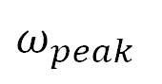
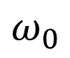
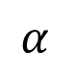
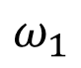
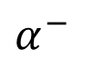
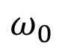
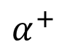
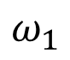
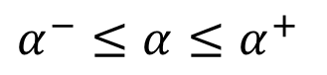
Related Works
Model – Adaptive-Variable Rate / Rhythmic Biondi et al. [ICCPS ‘15], Kim et al. [ICCPS ‘12]
Constant Acceleration between Jobs
Variable Acceleration between Jobs
Schedulability Guo and Baruah [ICCPS ‘15]
Exact Worst-case Demand Biondi et al. [ECRTS ‘14]
Exact Worst-case Demand via DRT Mohaqeqi et al. [ECRTS ‘17]
Exact Worst-case Demand via Knapsack
(This work)
$$α^{−}≤α≤α^{+}$$
$$ω_{peak}$$
$$α^{−}$$
$$α^{+}$$
$$α$$
$$ω_{1}$$
$$ω_{1}$$
$$ω_{0}$$
$$ω_{0}$$

Slide 22
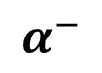
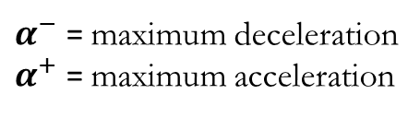
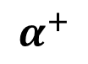
Related Works
Model – Adaptive-Variable Rate / Rhythmic Biondi et al. [ICCPS ‘15], Kim et al. [ICCPS ‘12]
Constant Acceleration between Jobs
Variable Acceleration between Jobs
Schedulability Guo and Baruah [ICCPS ‘15]
Exact Worst-case Demand Biondi et al. [ECRTS ‘14]
Exact Worst-case Demand via DRT Mohaqeqi et al. [ECRTS ‘17]
Exact Worst-case Demand via Knapsack
(This work)
$$α^{−}$$
$$α^{+}$$
$α^{−}$ = maximum deceleration
$α^{+}$ = maximum acceleration

Slide 23
Outline
Approach and Contributions
Background & Related Work
Precedence Constraints & Search Space Reduction
Worst-Case AVR Demand as Knapsack Problem
Evaluation & Results
Conclusion & Future Work
Notes:
Overview

Slide 24
Precedence Constraints & Search Space Reduction

Slide 25
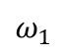
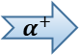
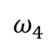






Acceleration Limits (on AVR)
$$c_{1}$$
$${ α≯α}^{+}$$
Execution Times of the Modes
$$c_{2}$$
$$c_{3}$$
$$α^{+}$$
$$α$$
$$c_{4}$$
$$c_{5}$$
$$c_{M}$$
$$ω_{0}$$
$$ω_{1}$$
$$ω_{2}$$
$$ω_{3}$$
$$ω_{4}$$
$$ω_{5}$$
$$ω_{min}$$
$$ω_{{rb}_{1}}$$
$$ω_{{rb}_{2}}$$
$$ω_{{rb}_{3}}$$
$$ω_{{rb}_{4}}$$
$$ω_{{rb}_{5}}$$
$$ω_{max}$$
c – execution time
$ω$ – angular speed
Reachable Speeds
Notes:
Consider the AVR graph that we are familiar from the previous slides.

Slide 26

Search Space Reduction: Dominant Sequences
A dominant sequence is a sequence of job releases which maximizes demand over a time interval $δ$.
Notes:
To help us reduce the search space, we rely on the concept of “Dominant Sequences”. A dominant sequence is…

Slide 27




Dominant Sequence Visualized
Max. Accel. ($α^{+}$)
$$c_{1}$$
Execution Times of the Modes
Max. Decel. ($α^{−}$)
$$c_{2}$$
$$ω_{peak}$$
Var. Accel.
$$c_{3}$$
$$ω_{1}$$
$$ω_{0}$$
$$c_{4}$$
$$c_{5}$$
A dominant sequence is a sequence of job releases which maximizes demand over a time interval $δ$.
$$c_{M}$$
$$ω_{min}$$
$$ω_{{rb}_{1}}$$
$$ω_{{rb}_{2}}$$
$$ω_{{rb}_{3}}$$
$$ω_{{rb}_{4}}$$
$$ω_{{rb}_{5}}$$
$$ω_{max}$$
c – execution time
$ω$ – angular speed
Speeds
Notes:
To visualize the need for these sequences, suppose we have three separate sequences. Each sequence with slight variations from the others. Some only decrease, some use variable acceleration, and some use only maximum acceleration.​

Slide 28


Dominant Sequence Visualized
Max. Accel. ($α^{+}$)
$$c_{1}$$
Execution Times of the Modes
Max. Decel. ($α^{−}$)
$$c_{2}$$
$$ω_{peak}$$
Var. Accel.
$$c_{3}$$
$$ω_{1}$$
$$ω_{0}$$
$$c_{4}$$
$$c_{5}$$
A dominant sequence is a sequence of job releases which maximizes demand over a time interval $δ$.
$$c_{M}$$
$$ω_{min}$$
$$ω_{{rb}_{1}}$$
$$ω_{{rb}_{2}}$$
$$ω_{{rb}_{3}}$$
$$ω_{{rb}_{4}}$$
$$ω_{{rb}_{5}}$$
$$ω_{max}$$
c – execution time
$ω$ – angular speed
Speeds
Notes:
We prove characteristics of dominant sequences that allow us to compare these sequences...​

Slide 29




Dominant Sequence Visualized
Max. Accel. ($α^{+}$)
$$c_{1}$$
Execution Times of the Modes
Max. Decel. ($α^{−}$)
$$c_{2}$$
$$ω_{peak}$$
Var. Accel.
$$c_{3}$$
$$ω_{1}$$
$$ω_{0}$$
$$c_{4}$$
$$>$$
$$>$$
$$c_{5}$$
A dominant sequence is a sequence of job releases which maximizes demand over a time interval $δ$.
$$c_{M}$$
We only search for dominant sequences!
$$ω_{min}$$
$$ω_{{rb}_{1}}$$
$$ω_{{rb}_{2}}$$
$$ω_{{rb}_{3}}$$
$$ω_{{rb}_{4}}$$
$$ω_{{rb}_{5}}$$
$$ω_{max}$$
c – execution time
$ω$ – angular speed
Speeds
Notes:
… and establish which sequence maximizes demand over the same timer interval. Because of this, we only search for dominant sequences across the range of available speeds.​

Slide 30





























Properties of a Dominant Sequence
Decreasing sequences can be transformed into non-decreasing sequences with equal or greater demand!
Max. Accel. ($α^{+}$)
Lemma 1 : Dominant sequences do not contain any decreasing subsequences.
Max. Decel. ($α^{−}$)
$$c_{1}$$
$$c_{1}$$
$$ω_{peak}$$
$$c_{2}$$
Var. Accel.
$$c_{2}$$
Lemma 1: Only non-decreasing sequences allowed.
$$ω_{1}$$
$$ω_{0}$$
$$c_{3}$$
$$c_{3}$$
$$c_{4}$$
$$c_{4}$$
$$c_{5}$$
$$c_{5}$$
$$c_{M}$$
$$c_{M}$$
$$ω_{min}$$
$$ω_{{rb}_{1}}$$
$$ω_{{rb}_{2}}$$
$$ω_{{rb}_{3}}$$
$$ω_{{rb}_{4}}$$
$$ω_{{rb}_{5}}$$
$$ω_{max}$$
$$ω_{min}$$
$$ω_{{rb}_{1}}$$
$$ω_{{rb}_{2}}$$
$$ω_{{rb}_{3}}$$
$$ω_{{rb}_{4}}$$
$$ω_{{rb}_{5}}$$
$$ω_{max}$$
Speeds
Speeds
Notes:
Lemma 1 says that

Slide 31




Properties of a Dominant Sequence
Lemma 2 : The first job of a dominant sequence begins at a right boundary.
n jobs in the middle of a step
n jobs at the right boundary speed
Lemma 2: Start at a right boundary speed (RB).
$$c_{m−1}$$
$$c_{m}$$
$$ω_{{rb}_{x}}$$
Same execution time, shorter time
$$↔$$
Notes:
Lemma 2 says

Slide 32








Properties of a Dominant Sequence
Lemma 3 : Dominant sequences have fixed choices for next speeds.
Decision Speed
Option 1 Max. Accel.
$$c_{m−1}$$
$$c_{m−1}$$
Lemma 3: Use maximum acceleration. Additionally, at decision speeds, use variable acceleration to reach RB.
Can release multiple jobs at RB.
Use Max. Accel.
$$c_{m}$$
$$c_{m}$$
$$ω_{{rb}_{x}}$$
$$ω_{{rb}_{x}}$$
When $α^{+}$ travels past right boundary, variable accel. may be used.
Option 2
Single Var. Accel.
$×$ n
RBs Multiple and
Max. Accel.
$$c_{m−1}$$
$$c_{m−1}$$
$$c_{m}$$
$$c_{m}$$
$$ω_{{rb}_{x}}$$
$$ω_{{rb}_{x}}$$
Notes:
Lemma 3 gives us the choice of speeds given the current speed

Slide 33













Dominant Sequence Visualization
Execution Times of the Modes
$$c_{1}$$
$$c_{2}$$
$$c_{3}$$
$$c_{4}$$
$$c_{5}$$
$$c_{M}$$
$$ω_{min}$$
$$ω_{{rb}_{1}}$$
$$ω_{{rb}_{2}}$$
$$ω_{{rb}_{3}}$$
$$ω_{{rb}_{4}}$$
$$ω_{{rb}_{5}}$$
$$ω_{max}$$
Speeds
Notes:
To put the lemmas into context, we will now visualize the dominant sequence

Slide 34





Dominant Sequence Visualization
Max. Accel. ($α^{+}$)
Max. Decel. ($α^{−}$)
$$c_{m−2}$$
$$ω_{peak}$$
Var. Accel.
$$ω_{1}$$
$$ω_{0}$$
$$c_{m−1}$$
$$c_{m}$$
$$ω_{{rb}_{x}}$$
$$ω_{{rb}_{x+1}}$$
Lemma 1: Only non-decreasing sequences allowed.
Lemma 3: Use maximum acceleration. Additionally, at decision speeds, use variable acceleration to reach RB.
Can release multiple jobs at RB.
Lemma 2: Start at a right boundary speed (RB).

Slide 35





A Visual Comparison
$$c_{m−2}$$
$$c_{m−1}$$
$$c_{m}$$
$$ω_{{rb}_{x}}$$
$$ω_{{rb}_{x+1}}$$
$$ω_{{rb}_{x}}$$
$$ω_{{rb}_{x+1}}$$
Sequence in our approach
Sequences in previous work
Search space in our approach is significantly reduced.
Notes:
To put this in perspective, we compare our approach with the DRT approach

Slide 36
Worst-Case Demand as Knapsack
Notes:
We now transform the problem into…

Slide 37



Jobs as Items, Time as Knapsack
ID
Initial Speed,
Final Speed
Item #1
$$ω_{0},ω_{1}$$
Profit
WCET
$ 2
$$c\left(ω_{0}\right)$$
Weight
Min. Interarrival (time)
17 kg
Max 100 sec.
$$\tilde{T}\left(ω_{0},ω_{1}\right)$$
Max 100 kg
Knapsack = Duration of time
37
Notes:
In the traditional knapsack problem….

Slide 38














Transformation Visualization
Execution Times of the Modes
$$c_{1}$$
$$c_{2}$$
0
t
$$c_{3}$$
$$c_{4}$$
$$ω_{j},ω_{k}$$
$$c_{5}$$
$$c_{M}$$
0
t
$$ω_{min}$$
$$ω_{{rb}_{1}}$$
$$ω_{{rb}_{2}}$$
$$ω_{{rb}_{3}}$$
$$ω_{{rb}_{4}}$$
$$ω_{{rb}_{5}}$$
$$ω_{max}$$
Precedence Constraints should be followed too
Speeds
Notes:
Let us visualize the transformation…

Slide 39




















Bounded Precedence Constraint Knapsack Problem
$c(ω_{j})$ – Execution time
$\tilde{T}$ - Job inter-arrival time
BPCKP
$$c(ω_{j})$$
Right boundary speed
$\tilde{T}$($ω_{j}$, $ω_{j}$)
$\tilde{T}$(${ω_{j},ω}_{k}$)
$$c(ω_{j})$$
$$c(ω_{k})$$
Decision Speed
$\tilde{T}$($ω_{j}$, $ω_{j}$)
$\tilde{T}$(${ω_{k},ω}_{l}$)
Middle of a step
$$c(ω_{j})$$
$$c(ω_{l})$$
$\tilde{T}$(${ω_{j},ω}_{k}$)
$\tilde{T}$($ω_{l},ω_{m}$)
$$c(ω_{k})$$
$$c(ω_{m})$$
$\tilde{T}$(${ω_{m},ω}_{n}$)
$\tilde{T}$(${ω_{m},ω}_{o}$)
$$c(ω_{n})$$
$$c(ω_{o})$$
$\tilde{T}$($ω_{n}$, $ω_{n}$)
$$c(ω_{n})$$

Slide 40




















$c(ω_{j})$ – Execution time
$\tilde{T}$ - Job inter-arrival time
BPCKP
$$c(ω_{j})$$
$\tilde{T}$($ω_{j}$, $ω_{j}$)
$\tilde{T}$(${ω_{j},ω}_{k}$)
$$c(ω_{j})$$
$$c(ω_{k})$$
$\tilde{T}$($ω_{j}$, $ω_{j}$)
$\tilde{T}$(${ω_{k},ω}_{l}$)
Multiple jobs at RBs –Restricted by the length of the time-interval
$$c(ω_{j})$$
$$c(ω_{l})$$
$\tilde{T}$(${ω_{j},ω}_{k}$)
$\tilde{T}$($ω_{l},ω_{m}$)
$$c(ω_{k})$$
$$c(ω_{m})$$
$\tilde{T}$(${ω_{m},ω}_{n}$)
$\tilde{T}$(${ω_{m},ω}_{o}$)
$$c(ω_{n})$$
$$c(ω_{o})$$
Solve the resultant BPCKP with Dynamic Programming
$\tilde{T}$($ω_{n}$, $ω_{n}$)
$$c(ω_{n})$$
Notes:
We mention that multiple jobs can be released at the right boundary speeds.

Slide 41


Time complexity
Number of Unique Items in Knapsack:
$$O(m\frac{ω_{max}^{2}−ω_{min}^{2}}{2α_{max}})$$
$m$ – number of modes
Search complexity – Pseudo polynomial
Same as any bounded precedence constraint knapsack problem
Notes:
We share a similar complexity when to calculating the number of unique items in the knapsack with the DRT approach.

Slide 42
Evaluation and Results
Notes:
We now move on to the results section

Slide 43


AVR Task Set: Table Comparison
Task Set in Previous Work
$i^{th}$ mode | 1 | 2 | 3 | 4 | 5 | 6 | $$ω_{{rb}_{m}}$$
$$ω_{{rb}_{i}}$$ | 500 | 1500 | 2500 | 3500 | 4500 | 5500 | 6500
$${c(ω}_{{rb}_{m}})$$ | 965 | 576 | 424 | 343 | 277 | 246
$ω_{rb_{i}}$ is reachable from $ω_{rb_{i−k}}$ in integer rotations
Decreases the number of decision speeds
A More Challenging Task Set
$i^{th}$ mode | 1 | 2 | 3 | 4 | 5 | 6 | $$ω_{{rb}_{m}}$$
$$ω_{{rb}_{i}}$$ | 1200 | 2200 | 3200 | 4200 | 5200 | 6200 | 7200
$${c(ω}_{{rb}_{m}})$$ | 965 | 576 | 424 | 343 | 277 | 246
$ω_{rb_{i}}$ is not reachable from $ω_{r−k}$ in integer rotations
Notes:
The problem statement of our approach…

Slide 44










AVR Task Set: Visual Comparison
$$c_{m−2}$$
Previous Work Task Set
# Decision Speeds less than # Modes
$$c_{m−1}$$
Fewer sequences
in the search space
$$c_{m}$$
$$ω_{{rb}_{x}}$$
$$ω_{{rb}_{x+1}}$$
More Challenging Task Set
$$c_{m−2}$$
# Decision Speeds equal to # Modes
$$c_{m−1}$$
More sequences in the search space
$$c_{m}$$
$$ω_{{rb}_{x}}$$
$$ω_{{rb}_{x+1}}$$
Notes:
To visualize this

Slide 45
Algorithm Runtime Comparison
System: Python 3.6.5, 3.4 GHz quad-core processor, 8 GB RAM
Experiment: Calculate worst-case demand for 100 intervals from [0,1s]
 | Previous Task Set | More Challenging Task Set
DRT Alg. | 3 min. 31 sec. | 17 min. 2 sec.
Our Alg. | 15.63 sec. | 19.24 sec.
Performance Improvement | 13.5 | 53.1

Slide 46

Random Taskset Alg. Runtimes

Slide 47

Public Artifact
http://bit.ly/ RTSS18KAVR
Recreate paper results
Customize task sets
Graphical comparison
Python w/ Markdown documentation

Slide 48





Engine Control Future Work
Relax the symmetric acceleration assumptions
$$α^{−}$$
$$≠$$
$$α^{+}$$
Additional problem dimensions
AVR tasks with different phases
θ
~
Approximation algorithms
Notes:
For future work, we aim to relax the symmetric acceleration assumptions, increase the number of problem dimensions to include things like temperature and pressure, apply approximation algorithms to the knapsack approach, and handle AVR tasks with different phases.

Slide 49





Engine Control Conclusion
1. Worst-case AVR task demand ↔ Bounded precedence constraint knapsack problem (BPCKP).
↔
2. Symmetric acceleration + Engine kinematics → Reduced search space.
$$α^{−}$$
$$α^{+}$$
→
3. Results significantly outperform the state-of-the-art in computation time.
?
Questions?
sandeepb@vt.edu
aaron.willcock@wayne.edu
tchantem@vt.edu
fishern@wayne.edu
http://bit.ly/RTSS18KAVR
Notes:
"We make a simplifying assumption that magnitude of acceleration and deceleration is equal"

Slide 50
Future Work
Prospectus Defense - Aaron Willcock (aaron.willcock@wayne.edu)
Advisor – Professor Nathan Fisher (fishern@wayne.edu)

Slide 51
Timeline

Slide 52
Publications
Prospectus Defense - Aaron Willcock (aaron.willcock@wayne.edu)
Advisor – Professor Nathan Fisher (fishern@wayne.edu)

Slide 53
Concluding Summary
Prospectus Defense - Aaron Willcock (aaron.willcock@wayne.edu)
Advisor – Professor Nathan Fisher (fishern@wayne.edu)

Slide 54
Appendix

Slide 55

Random Taskset Alg. Runtimes (Log)

Slide 56

Rand. Taskset Knapsack Runtimes

Slide 57
Standalone AVR Function
$$c_{1}$$
Execution Times of the modes
$$c_{2}$$
$$c_{3}$$
$$c_{4}$$
$$c_{5}$$
$$c_{M}$$
$$ω_{min}$$
$$ω_{{rb}_{1}}$$
$$ω_{{rb}_{2}}$$
$$ω_{{rb}_{3}}$$
$$ω_{{rb}_{4}}$$
$$ω_{{rb}_{5}}$$
$$ω_{max}$$
c – execution time
$ω$ – angular speed
Speeds
Biondi et al. [ICCPS ‘15]

Slide 58




Why assume $\left|α^{−}\right|=α^{+}$?
$$α^{+}$$
1. How does the problem change when $\left|α^{−}\right|=α^{+}$?
2. Are there non-trivial exploits?
3. What intuitions can we gather about DRT vs BPCKP?
$${|α}^{−}|$$
4. How can we better map the solution space?

Slide 59






But my [insert rotational source] doesn’t have symmetric acceleration!
Increase magnitude of the lesser to match the larger.
$$α^{+}$$
$$α^{−}$$
$$α^{−}$$
$$α^{+}$$
$$α^{−}$$
$$α^{+}$$
Gives pessimistic worst-case demand for the original, asymmetric system.

Slide 60


But my [insert rotational source] doesn’t have symmetric acceleration!
$$α^{+}$$
Imagine a set of asymmetric systems.
Systems where $α^{+}>\left|α^{−}\right|$ artificially raise $\left|α^{−}\right|$.
Systems where $|α^{−}|>α^{+}$ artificially raise $α^{+}$.
$${|α}^{−}|$$
Gives pessimistic worst-case demand for the original, asymmetric system.

Slide 61

How does this compare to actual internal combustion engines?
$$α^{+}$$
Internal Combustion Engine Fundamentals, 2nd Edition by J.B. Heywood
Most internal combustion engines operating without load fall in the highlighted category.
Typically $α^{+}$ >> ${|α}^{−}|$
since friction is the primary cause of ${|α}^{−}|$
$${|α}^{−}|$$

